Slide 1
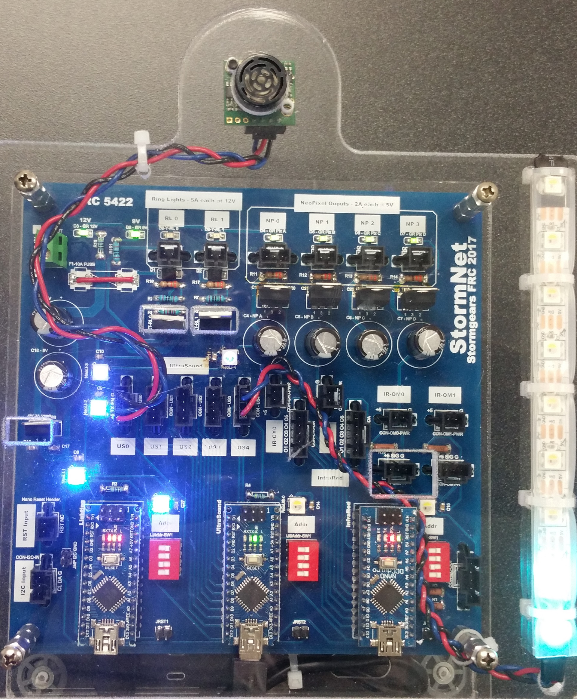
StormNet by Stormgears FRC Team #5422
Multi-Processor Sensor and Light Control Subsystem for FRC Robots
Supports 15 sensors and strings of programmable decorative lights
Scalable: can add additional Arduino’s (up to 255) as desired to expand functionality
Accelerates robot development: functional partitioning of functionality into a set of Arduino’s facilates concurrent development by multiple student contributors, while offloading and simplifying Roborio code development
Increases robot reliability: all cabling standardized on locking molex SL Series connectors

Slide 2
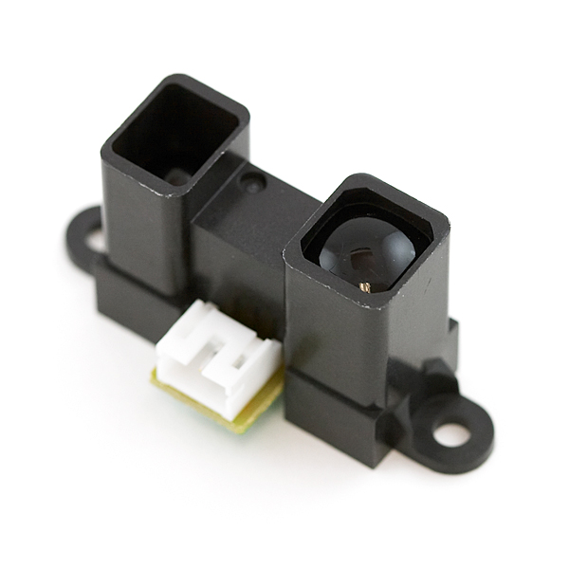
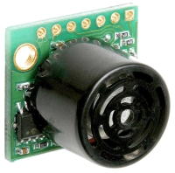
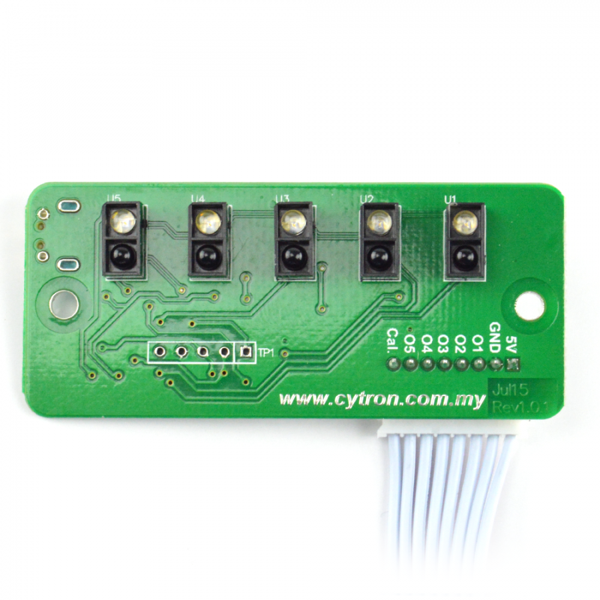
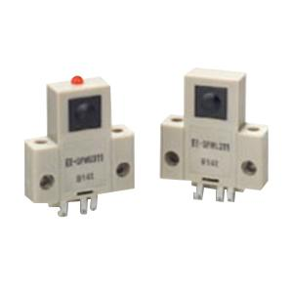
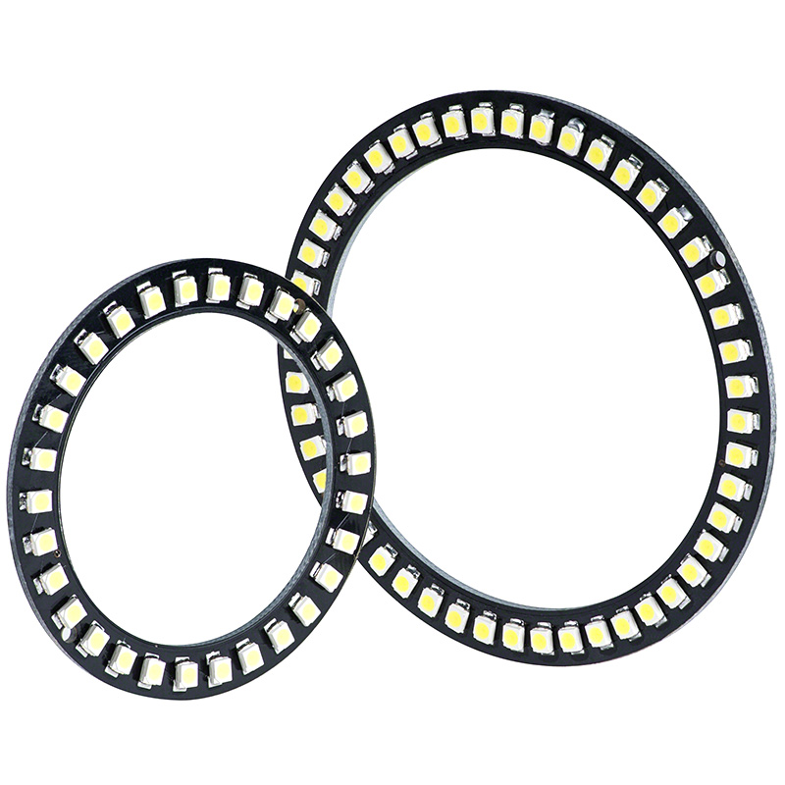
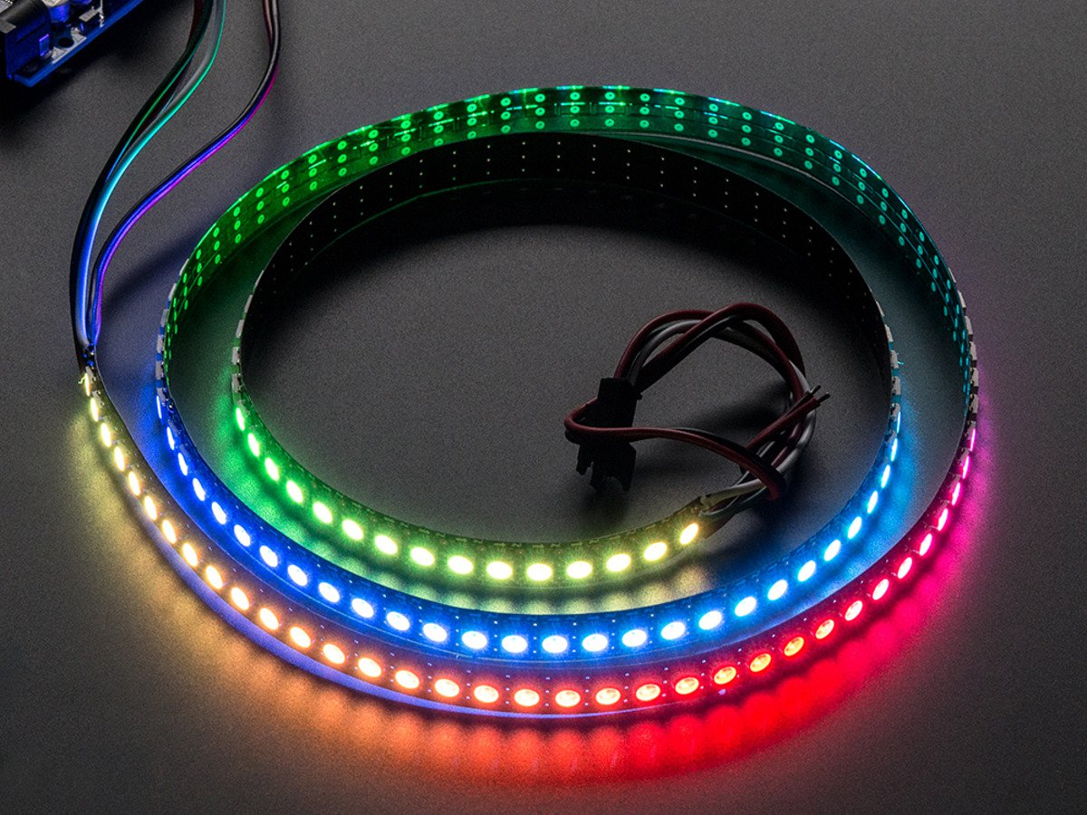
Sensors supported:
Sharp Infrared Distance Measuring Sensor Units
GP2Y0A51SK0F: 2-15 centimeter range
GP2Y0A21YK0F: 10-80 centimeter range
GP2Y0A60SZLF: 20-150 centimeter range
Maxbotix Sonar Range Finders (-EZ Series)
Omron Thru-Beam Photo Microsensor
Cytron retroreflective IR line sensor
Lighting supported:
LED light rings or strings: two MOSFET on/off power circuits (up to 2 Amps each)
Neopixels: up to 4 strings with separate power supplies (up to 2 Amps each)

Slide 3
StormNet Design
I2C Master-Slave communications architecture
Application functionality distributed across multiple Arduino microcontrollers
Interface circuitry for variety of sensors and lights
Arduino software performs data logic and filtering and logic, offloading Roborio
Simple Arduino command structure for Roborio via i2c.
Diagnostic interface on USB port of each Arduino
I2c watchdog logic flashes LED on Arduino’s based on communication bus status
Roborio
MASTER
Lighting Controller
Infrared Controller
Sonar Range Finder Controller
SLAVE
SLAVE
SLAVE
NeoPixel1
IR1
Sonar1
NeoPixel2
IR2
Sonar2
NeoPixel3
IR3
Sonar3
NeoPixel4
IR4
Sonar4
LED1
ThroughBeam1
Sonar5
LED2
ThroughBeam2
LineSensor1
LineSensor2

